Slide 1

POWER BI PROJECT
Summer Training — Power BI | CGC UNIVERSITY MOHALI
STUDENT EXAMS RESULTS ANALYZSIS
Presented by
Course
Guided by
Date
Nana Sirri CHE Lovette Claire | [2419712]
[B.Tech — Blockchain]
Dr ASHIMA
02/07/2026

Slide 2
Agenda
01
Problem Statement & Objective
06
Dashboard Walkthrough
02
Dataset Overview
07
Key Insights & Findings
03
Data Model — Star Schema
08
Publishing to Power BI Service
04
Power Query — Cleaning Steps
09
Challenges & Learnings
05
DAX Measures
10
Conclusion & Q&A
2 / 14

Slide 3
PROBLEM STATMENT &OBJECTIVES
PART01

Slide 4
Problem Statement & Objectives
The Problem
Target User
Students performance
This project aims to understand how student performance (test scores) is influenced by various factors, including Gender, Ethnicity, Parental Level of Education, Lunch, and Test Preparation Course.
Teachers, School Management ,Parents, Students and Education Analysts.
Project Objectives
Connect & clean the raw dataset using Power Query
Design an interactive multi-page dashboard with 5+ visual types
Build a star schema data model with correct relationships
Publish the final report to Power BI Service
Create at least 5 meaningful DAX measures
4 / 14

Slide 5
02 Dataset Overview
PART02
Source, structure, and key fields
5 / 14

Slide 6
Dataset Overview
https://www.kaggle.com/datasets/spscientist/students-performance-in-exams?datasetId=74977
kaggle
Excel
1000
8
Source
File Type
Rows
Columns
Key Columns Used
Data Quality Steps (Power Query)
Column | Role in Dashboard
Parental Level of Education | Measures impact of parents education on student performance
Gender | To compare performance between male and female students
Race/Ethnicity | To analyze score distribution across different groups
Scores | Measures students performance
Lunch | To study the relationship between nutrition and academic performance
Test Preparation Course | To compare scores before and after preparation
Removed duplicate rows
Fixed null values in [column]
Changed data types (Date, Number)
Renamed columns for clarity
Filtered out [cancelled/test] rows
6 / 14

Slide 7
Data Model
PART03
Star schema design & relationships.
Dataset Structure
Source: Student Exam Performance Dataset
Total Records: 1000 rows
Total Columns: 8 columns
Fields Used
Gender
Race/Ethnicity
Parental Level of Education
Lunch
Test Preparation Course
Math Score
Reading Score
Writing Score
Data Model Type
Single Table Model
Purpose
used to analysis student performance across demographics and exam scores
7 / 14

Slide 8
04 Dashboard Walkthrough
PART04
Pages, visuals, and interactivity
11 / 14

Slide 9
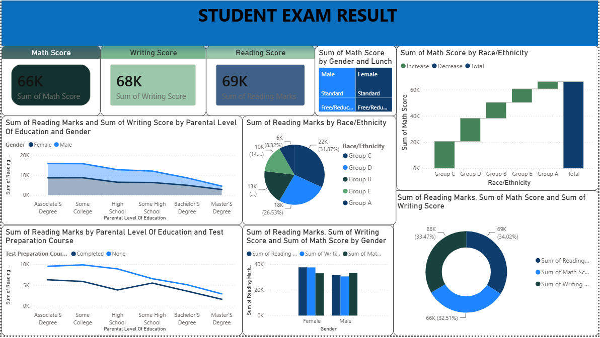
Dashboard — Page 1: Overview
Visuals on this page
KPI Cards — Maths, Reading, Writing Scores
Pie Chart — Sum of reading marks by race/ethnicity and Sum of all scores
Line Chart — Sum of reading marks by parental level of education and test preparation course
Bar Chart — Sum of reading and maths marks by gender
Waterfall — Sum of maths score by race/ethnicity
Key Insight
At a glance, this dashboard shows aggregate exam performance broken down by gender, race/ethnicity, parental education level and test preparation status. The visuals highlight patterns like Group A leading in math scores and test-prep completion correlating with higher reading scores, making it easy to spot which demographic factors influence results.
12 / 14

Slide 10
Key Findings & Insights
Female students performed slightly better overall
Parental education influences student scores
01
04
Reading and writing scores are strongly correlated
Performance varies across race/ethnicity groups
02
05
Test preparation course improves performance
03
13 / 14

Slide 11
Successfully built an end-to-end Power BI solution from raw data to published dashboard
Conclusion & Thank You
Increasing test prep course enrollment ,especially among students from lower parental-education backgrounds, could be the fastest, most equitable way to close the performance gap, since its positive effect holds true across every demographic segment shown.
Future scope: With time i will add results per semester
Questions & Feedback Welcome
14 / 14

